Slide 1
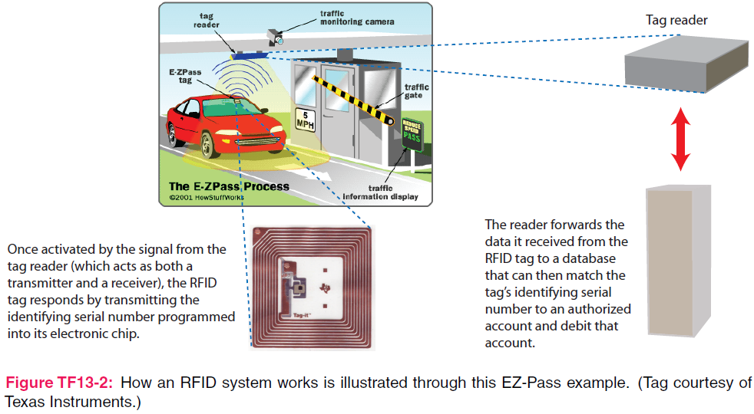
7. Plane Wave Propagation
7e Applied EM by Ulaby and Ravaioli

Slide 2
Chapter 7 Overview

Slide 3
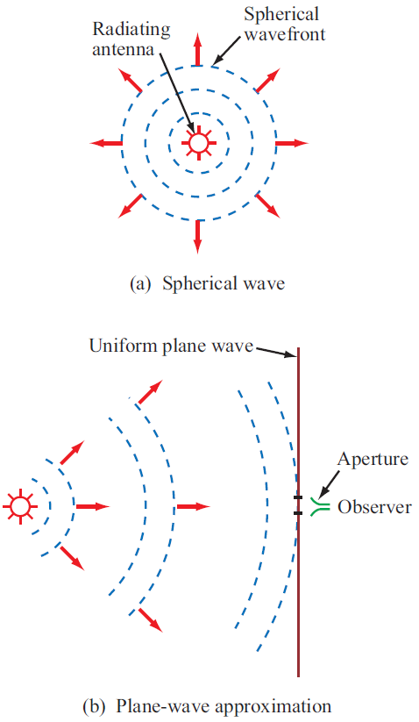
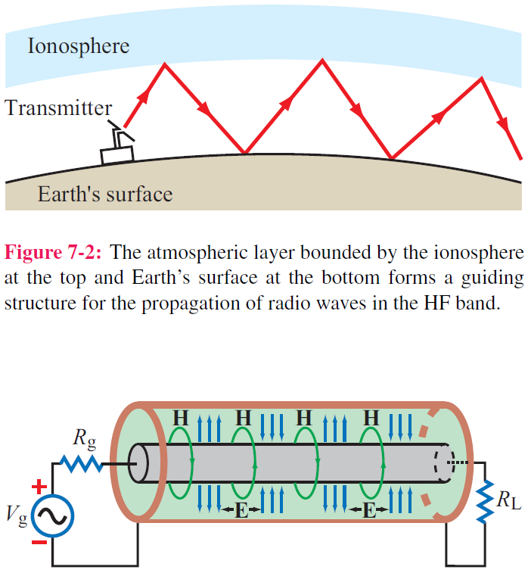
Guided EM Waves
Unbounded EM Waves

Slide 4
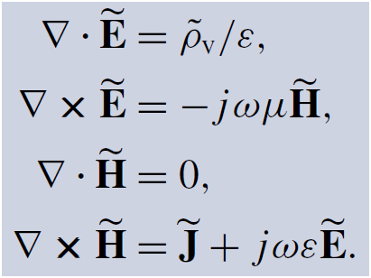
Time-Harmonic Fields
For sinusoidal time variations:

Slide 5
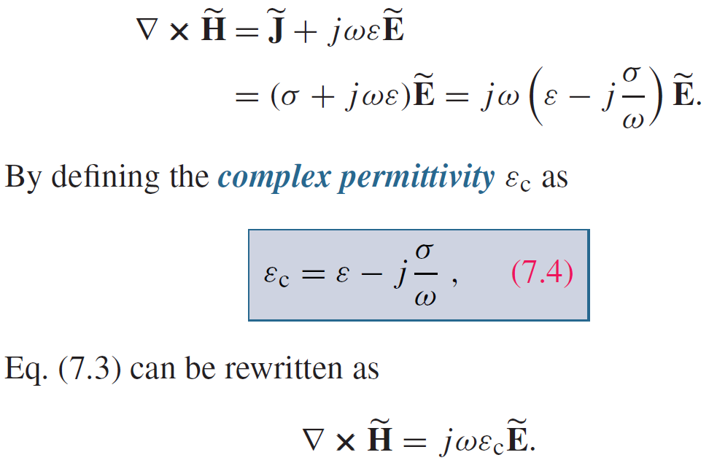
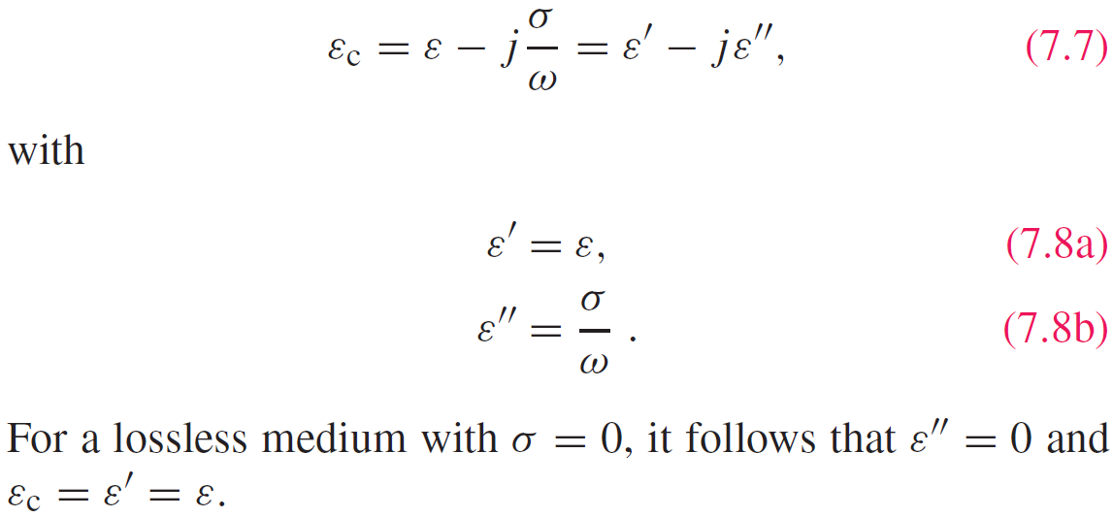
Complex Permittivity

Slide 6
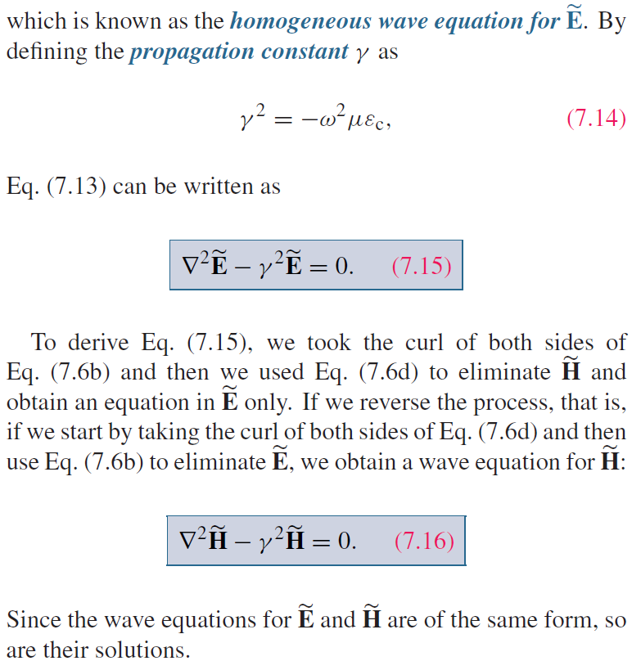
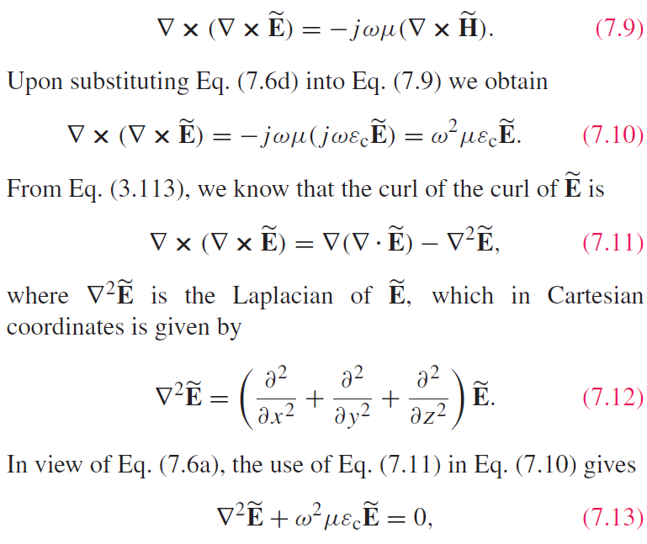
Wave Equations
Source free
Helmholtz equation

Slide 7
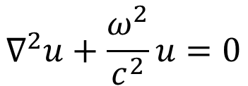
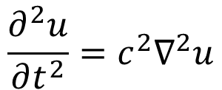
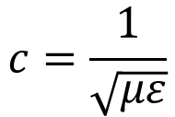
Wave Nature
Conventional wave equation
(mechanical displacement u of a wave)
$$\frac{∂^{2}u}{∂t^{2}}=c^{2}∇^{2}u$$
$$∇^{2}u+\frac{ω^{2}}{c^{2}}u=0$$
$$c=\frac{1}{\sqrt{με}}$$
Propagation Speed

Slide 8
Explanation of Wave Speed

Slide 9
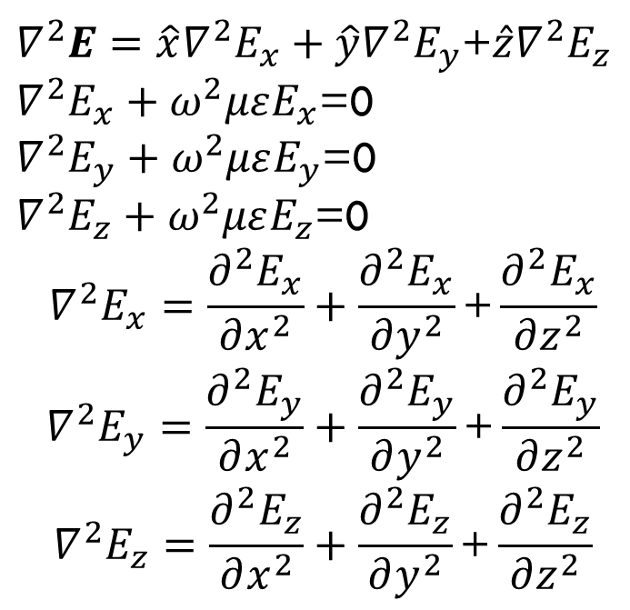
Wave Equation Expansion
$∇^{2}E=\hat{x}∇^{2}E_{x}+\hat{y}∇^{2}E_{y}$+$\hat{z}∇^{2}E_{z}$
$∇^{2}E_{x}+ω^{2}μεE_{x}$=0
$∇^{2}E_{y}+ω^{2}μεE_{y}$=0
$∇^{2}E_{z}+ω^{2}μεE_{z}$=0
$$∇^{2}E_{x}=\frac{∂^{2}E_{x}}{∂x^{2}}+\frac{∂^{2}E_{x}}{∂y^{2}}\text{+}\frac{∂^{2}E_{x}}{∂z^{2}}$$
$$∇^{2}E_{y}=\frac{∂^{2}E_{y}}{∂x^{2}}+\frac{∂^{2}E_{y}}{∂y^{2}}\text{+}\frac{∂^{2}E_{y}}{∂z^{2}}$$
$$∇^{2}E_{z}=\frac{∂^{2}E_{z}}{∂x^{2}}+\frac{∂^{2}E_{z}}{∂y^{2}}\text{+}\frac{∂^{2}E_{z}}{∂z^{2}}$$

Slide 10
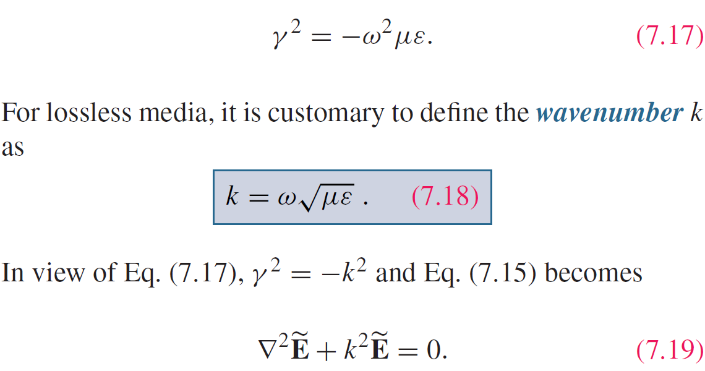
Lossless Media
If the medium is nonconducting (σ = 0), the wave does not suffer any attenuation as it travels and hence the medium is said to be lossless.

Slide 11
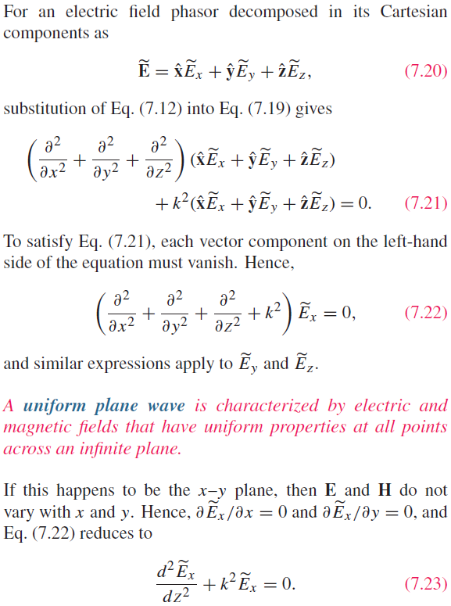
Uniform Plane Wave

Slide 12
Transverse Electromagnetic (TEM) Wave

Slide 13
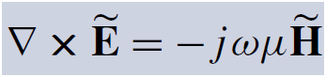
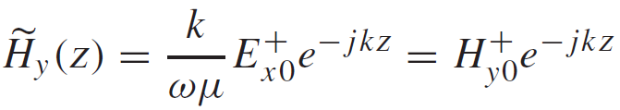
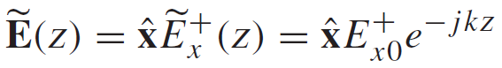
Uniform Plane Wave Solution
-z propagation
General Form of the Solution:
+z propagation
Application of
yields:
For a wave travelling along +z only:

Slide 14
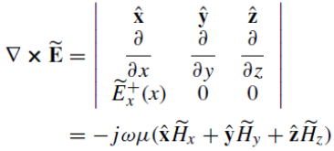
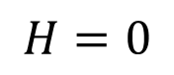
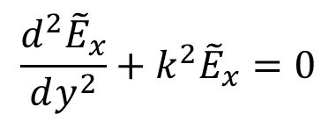
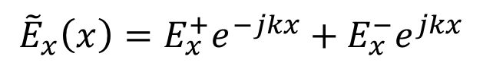
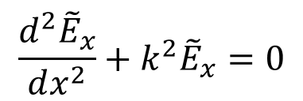
Proof of TEM Nature
Fields do not change with x and y
$$\frac{d^{2}{\tilde{E}}_{x}}{dy^{2}}+k^{2}{\tilde{E}}_{x}=0$$
Fields do not change with x and z
$$\frac{d^{2}{\tilde{E}}_{x}}{dx^{2}}+k^{2}{\tilde{E}}_{x}=0$$
Fields do not change with y and z
$${\tilde{E}}_{x}\left(x\right)=E_{x}^{+}e^{−jkx}+E_{x}^{−}e^{jkx}$$
$$H=0$$

Slide 15
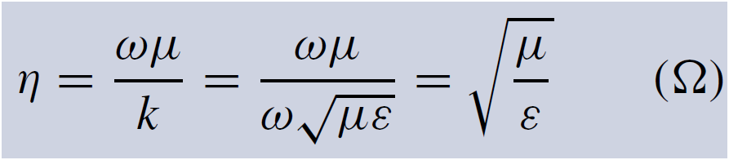
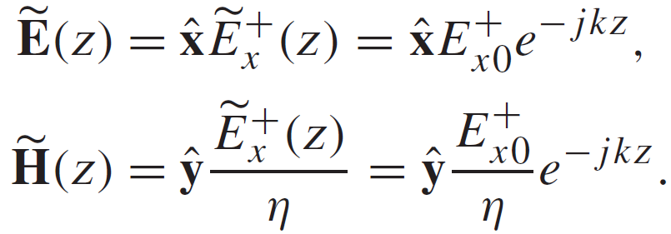
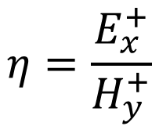
Intrinsic Impedance
$$η=\frac{E_{x}^{+}}{H_{y}^{+}}$$
Intrinsic impedance of the medium or wave impedance
Summary: This is a plane wave with

Slide 16
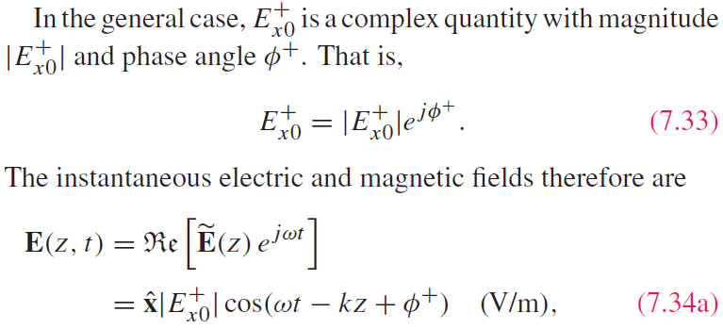
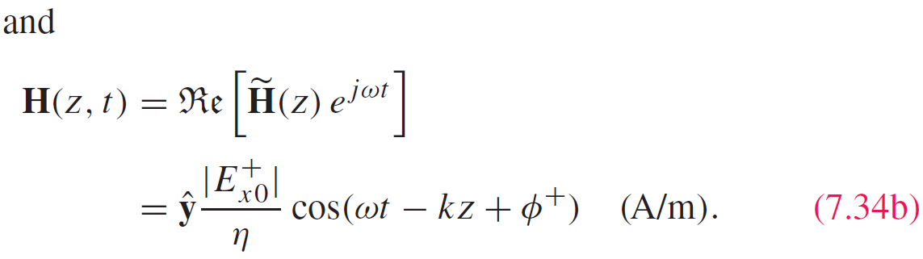
Time-Domain Solution

Slide 17
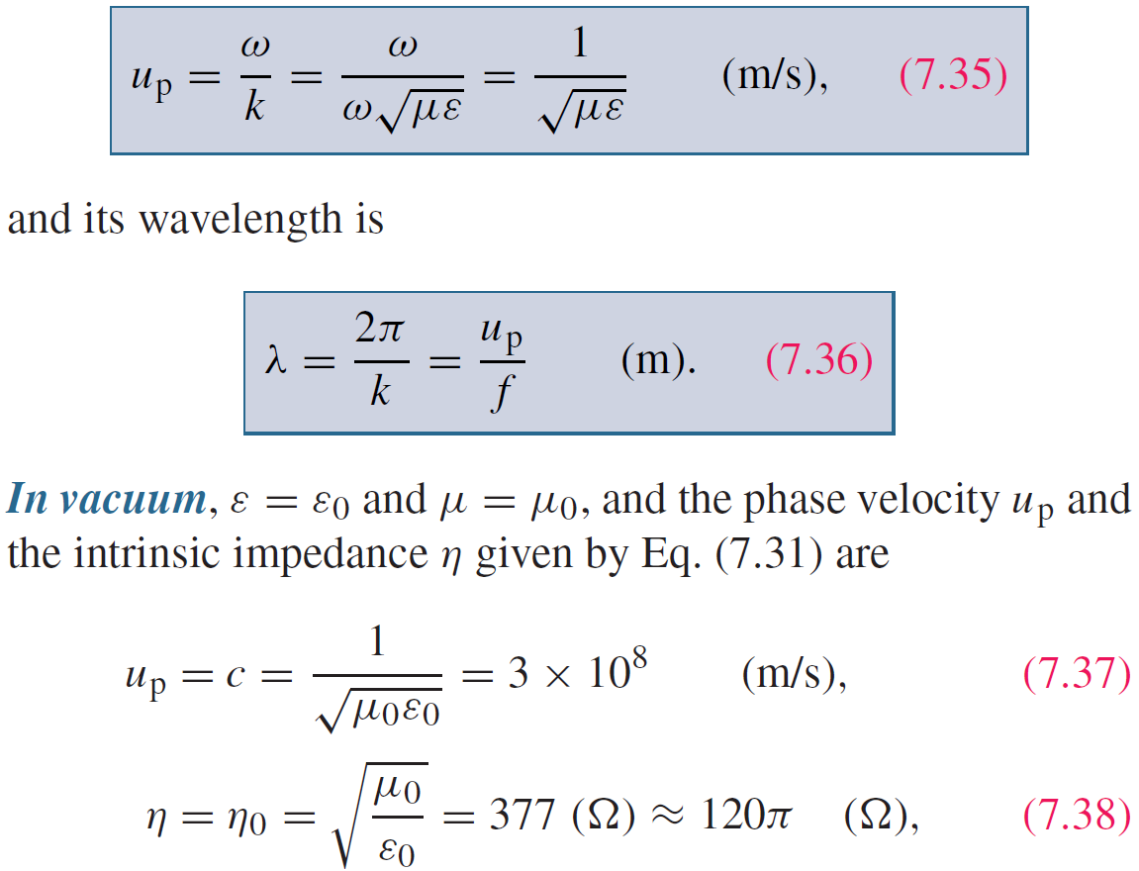
Wave’s Phase Velocity

Slide 18
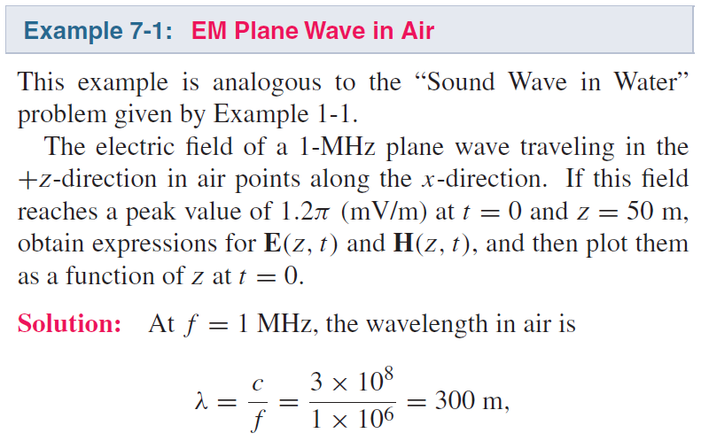
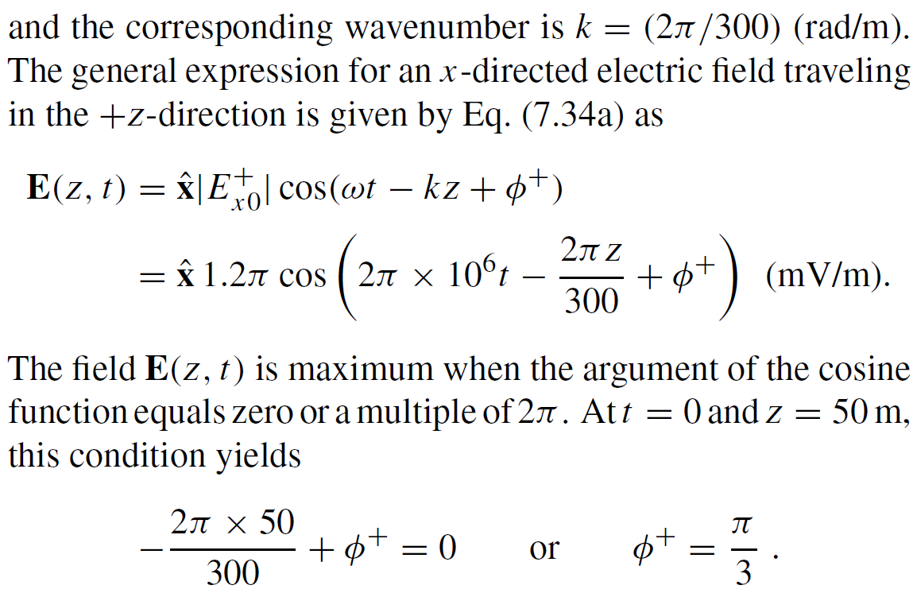
Cont.

Slide 19
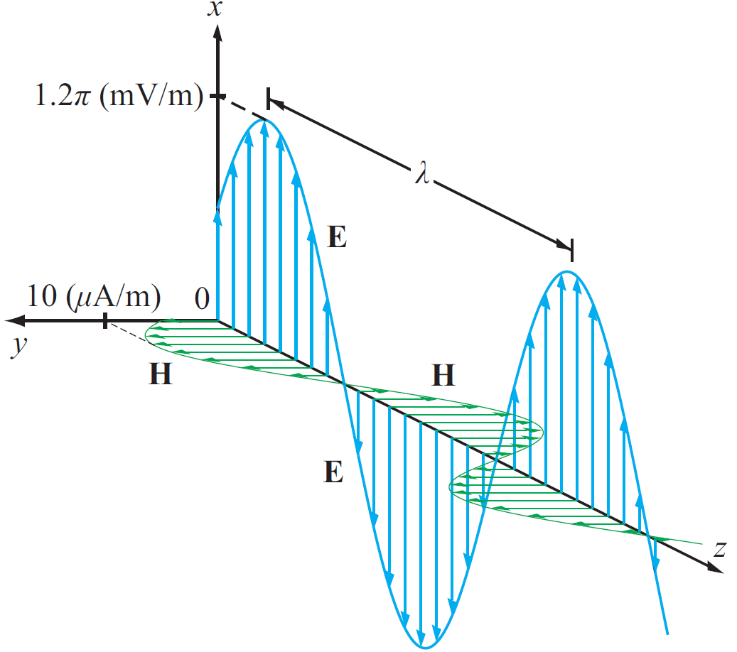
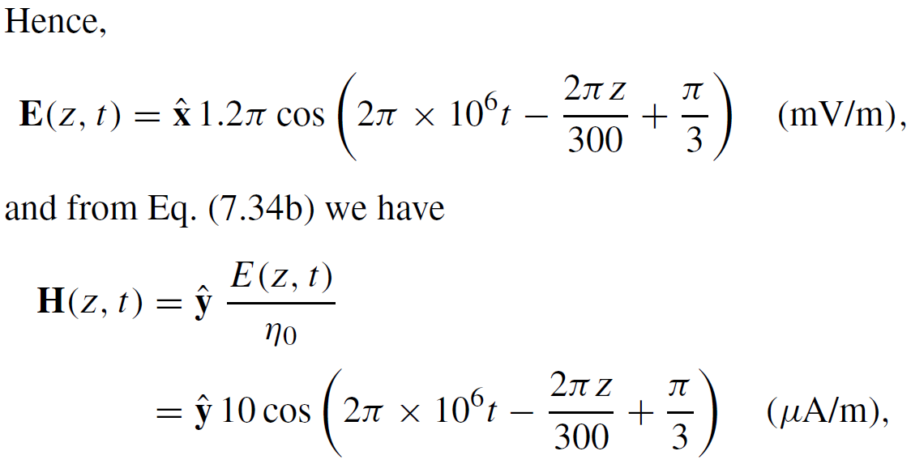
Example 7-1 cont.

Slide 20
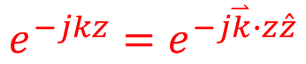
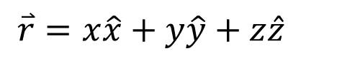
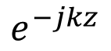
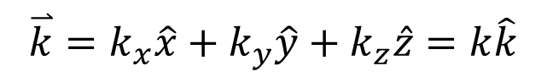
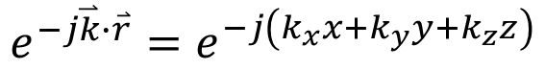
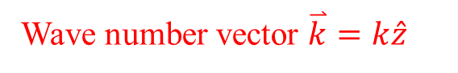
General Plane Wave
+z propagation
$$e^{−jkz}$$
Wave number vector $\overset{⃑}{k}=k\hat{z}$
$$e^{−jkz}=e^{−j\overset{⃑}{k}∙z\hat{z}}$$
General-direction propagation
$$e^{−j\overset{⃑}{k}∙\overset{⃑}{r}}=e^{−j\left(k_{x}x+k_{y}y+k_{z}z\right)}$$
$$\overset{⃑}{k}=k_{x}\hat{x}+k_{y}\hat{y}+k_{z}\hat{z}=k\hat{k}$$
$$\overset{⃑}{r}=x\hat{x}+y\hat{y}+z\hat{z}$$
$$\overset{⃑}{E}={\overset{⃑}{E}}_{0}e^{−j\overset{⃑}{k}∙\overset{⃑}{r}}=\left(A\hat{x}+B\hat{y}+C\hat{z}\right)e^{−j\overset{⃑}{k}∙\overset{⃑}{r}}$$

Slide 21
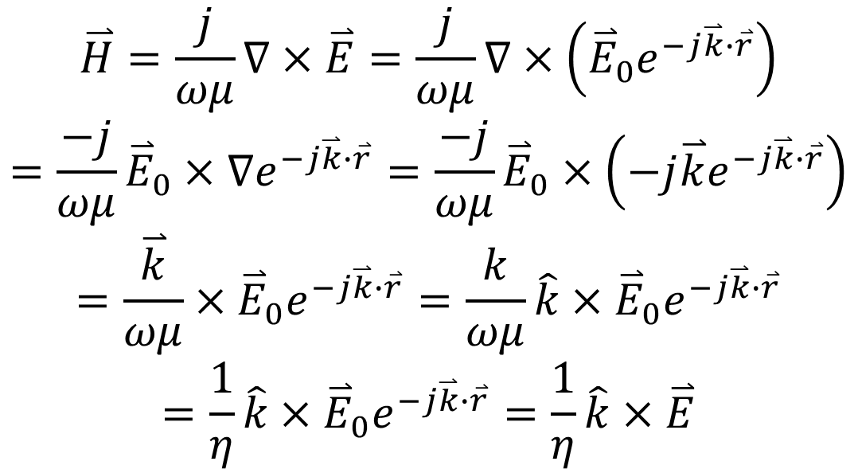
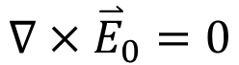
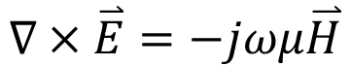
Directional Relation Between E and H
$$∇×\overset{⃑}{E}=−jωμ\overset{⃑}{H}$$

Slide 22
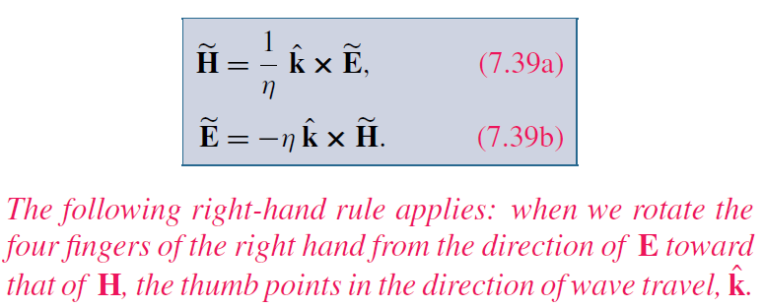
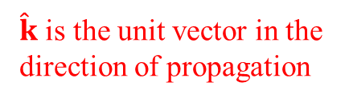
Cont.
For Any TEM Wave
$\hat{k}$ is the unit vector in the direction of propagation

Slide 23
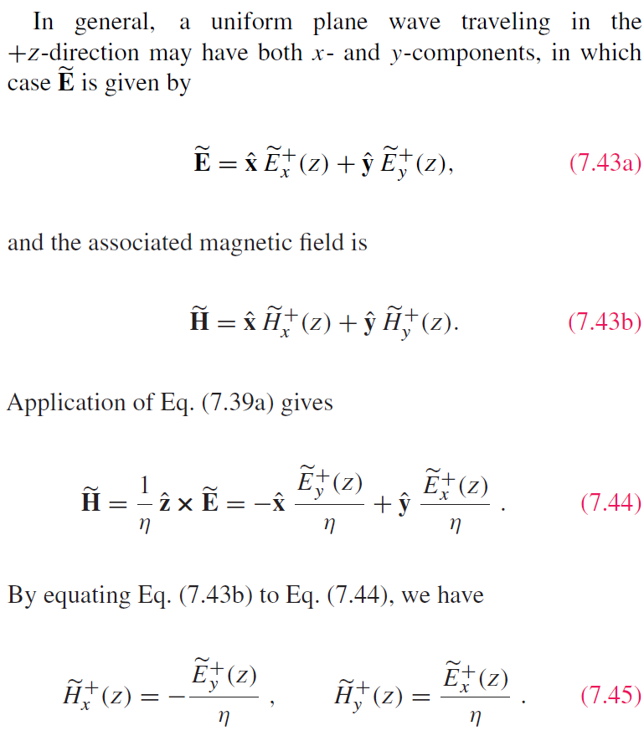
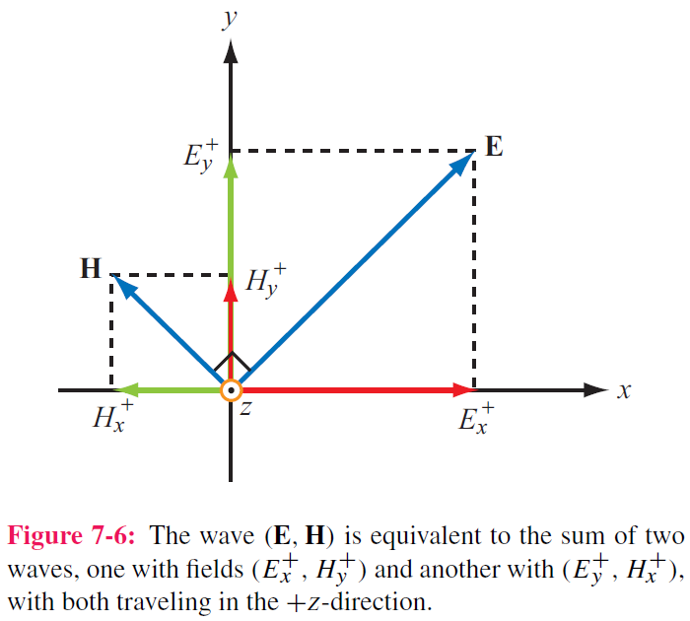
Wave decomposition

Slide 24
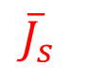
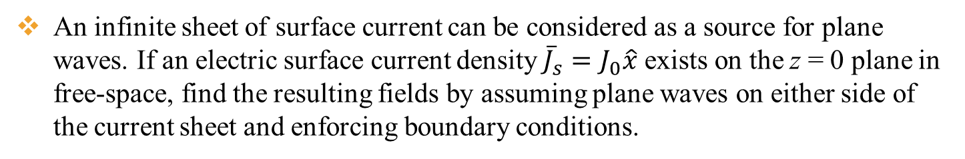
Example
An infinite sheet of surface current can be considered as a source for plane waves. If an electric surface current density ${\overline{J}}_{s}=J_{0}\hat{x}$ exists on the z = 0 plane in free-space, find the resulting fields by assuming plane waves on either side of the current sheet and enforcing boundary conditions.
x
Since source does not vary with x and y, the field does not either. So the wave only has z variation, propagating from the source to +z and −z directions
$${\overline{J}}_{s}$$
The boundary conditions at z = 0 are
z
y
H must be in the y direction and E must be in the x direction

Slide 25
Cont.
Then the fields can be written in the following form with A and B are arbitrary numbers representing field amplitudes in the z < 0 and z > 0 region
With the first boundary condition at z = 0 (E_{x} continuous), we get A = B
Use the second boundary condition at z = 0, we get − B − A = J₀ So A = B = − J₀ /2

Slide 26
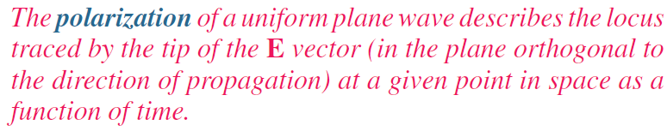
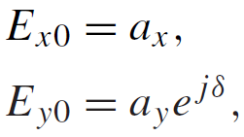
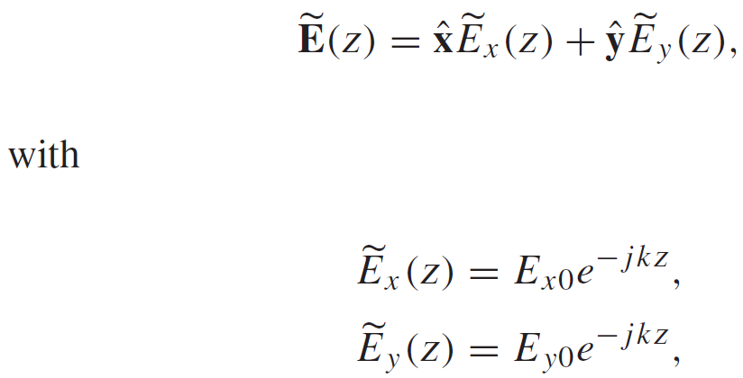


Wave Polarization
Phase difference
If:
Plane wave propagating along +z :
then
$$a_{x}≥0 a_{y}≥0$$
Generally complex numbers

Slide 27


Polarization State
Polarization state describes the trace of E as a function of time
at a fixed z
Magnitude of E
Inclination Angle

Slide 28



Linear Polarization:
or
E traces a line( in blue) as the wave traverses a fixed plane
Special cases

Slide 29




Circular Polarization
Polarization Handedness
Left-hand
Pay attention to the big black arrow
Right-hand

Slide 30


LH Circular Polarization:
y component is 90° ahead of x component
phase of x component needs to take T/4 to become the current phase of y component
Constant magnitude

Slide 31

RH Circular Polarization:
x component is 90° ahead of y component

Slide 32



Cont.

Slide 33
Example 7-2 cont.
Wave with electric field magnitude
of 3 (mV/m) traveling in the +y-direction
Cont.

Slide 34
Example 7-2 cont.

Slide 35




Elliptical Polarization: General Case
Linear and circular polarizations are special cases of elliptical polarization

Slide 36

Cont.

Slide 37


Example 7-3 cont.

Slide 38


Lossy Media
Lossless
Cont.

Slide 39

Lossy Media
Both are positive
Check when ε” = 0

Slide 40


Attenuation
E and H fields:
+z propagation
−z propagation
$$e^{γz}=e^{αz}e^{jβz}$$
Cont.

Slide 41


Attenuation
Magnitude of E
Skin depth

Slide 42


Phase Velocity and Wavelength
Lossless
Lossy
k is complex
$$u_{p}=\frac{ω}{β}$$
$$λ=\frac{2π}{β}$$

Slide 43

Low and High Frequency Approximations

Slide 44

Example 7-4: Plane Wave in Seawater
Cont.

Slide 45

Example 7-4: Plane Wave in Seawater
Cont.

Slide 46
Example 7-4: Plane Wave in Seawater
Cont.

Slide 47
Example 7-4: Plane Wave in Seawater
Cont.

Slide 48
Example 7-4: Plane Wave in Seawater

Slide 50

dc vs ac Current Flow in Conductors
Uniform distribution
Not uniform distribution

Slide 51



Linear Conductor
For a conductor with E₀ at the surface:
Total current crossing y-z plane:

Slide 52




Power Density
Poynting vector:
Total power intercepted by A:
Time-average power density:

Slide 53


Plane Wave in Lossless Medium
For a plane wave with E field :
the average power density carried by the wave is:

Slide 54





Plane Wave in Lossy Medium
For a plane wave travelling in a lossy medium:
the power density is :

Slide 55




Slide 56






Power Density of Different Polarization
$$\overset{⃑}{H}=\hat{y}\frac{E_{0}}{η_{0}}e^{−jkz}$$
Linear Polarization
$$\overset{⃑}{E}=\hat{x}E_{0}e^{−jkz}$$
$${\overset{⃑}{S}}_{av}=\frac{1}{2}Re\left[\overset{⃑}{E}×{\overset{⃑}{H}}^{∗}\right]=\hat{z}\frac{E_{0}^{2}}{2η_{0}}$$
Circular Polarization
$$\overset{⃑}{H}=\frac{E_{0}}{η_{0}}\left(\hat{y}−j\hat{x}\right)e^{−jkz}$$
$$\overset{⃑}{E}=E_{0}\left(\hat{x}+j\hat{y}\right)e^{−jkz}$$
$${\overset{⃑}{S}}_{av}=\frac{1}{2}Re\left[\overset{⃑}{E}×{\overset{⃑}{H}}^{∗}\right]=\frac{E_{0}^{2}}{2η_{0}}Re\left[\left(\hat{x}+j\hat{y}\right)e^{−jkz}×\left(\hat{y}+j\hat{x}\right)e^{jkz}\right]$$
$$=\frac{E_{0}^{2}}{2η_{0}}Re\left[\left(\hat{x}+j\hat{y}\right)×\left(\hat{y}+j\hat{x}\right)\right]=\frac{E_{0}^{2}}{2η_{0}}Re\left[\hat{z}+\hat{z}\right]=\hat{z}\frac{E_{0}^{2}}{η_{0}}$$
Total fields

Slide 57

Summary

